Slide 1
Grading Open Lab
2022-2023
Federal and State Compliance
Wanda Thomas, Sr. Manager
Federal & State Compliance
September 14, 2022
8:30-10:30 AM

Slide 2
Norms
Please mute your microphone and camera.
Place your questions in the chat.
Do not record these sessions.

Slide 3
Data Integrity
PEIMS Coordinators, attendance clerks, data entry clerks and SIR’s play an essential role in HISD’s efforts to ensure that all data is timely, accurate and properly documented.
In no case should paraprofessional personnel be responsible for determining students coding information for attendance, grading, program placement, or special services.

Slide 4
Six-Week Progress Report and Report Card Matrix
2022-2023 Grading Process

Slide 5
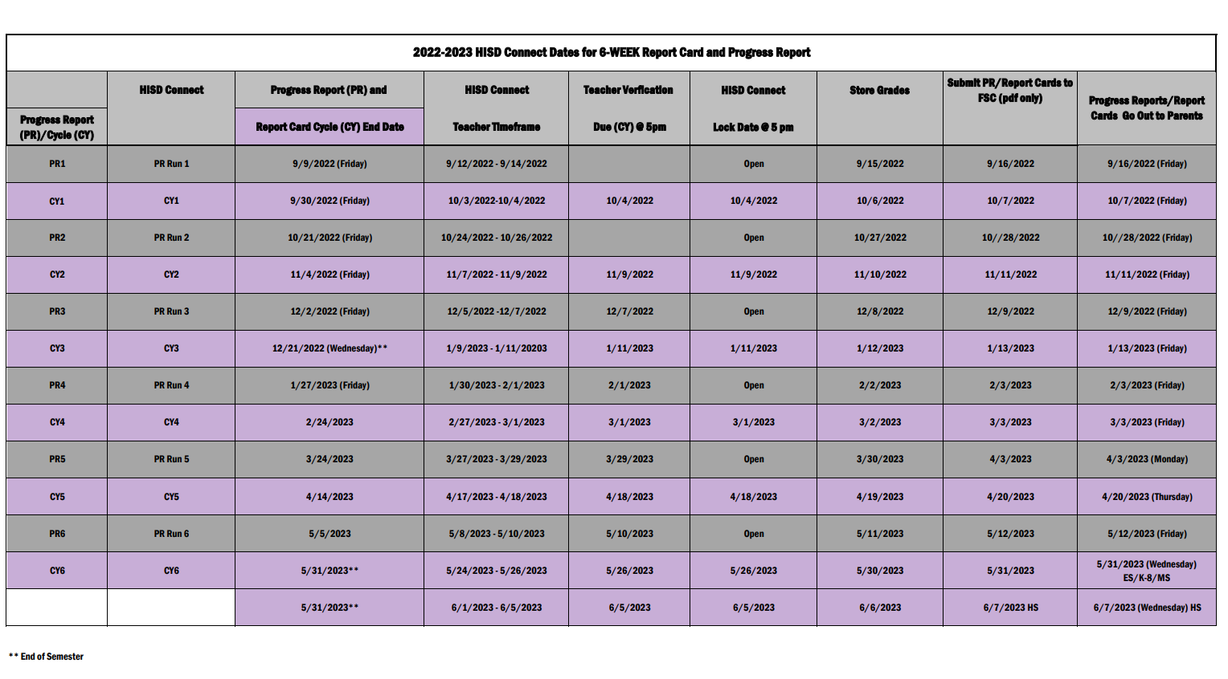
2021-2022 HISD Connect Dates for
6-Week Progress Reports and Report Cards
2021-2022 HISD Connect Dates for 6-WEEK Report Card and Progress Report
 | HISD Connect | Progress Report (PR) and | HISD Connect | Teacher Verfication | HISD Connect | Store Grades | Submit PR/Report Cards to FSC (pdf only) | Progress Reports/Report Cards Go Out to Parents
Progress Report (PR)/Cycle (CY) |  | Report Card Cycle (CY) End Date | Teacher Timeframe | Due (CY) @ 5p | Lock Date @ 12:01a
PR1 | PR Run 1 | 9/10/2021 (Friday) | 9/10/2021 |  | Open | 9/14/2021 | 9/15/2021 | 09/15/2021 (Friday)
CY1 | CY1 | 10/01/2021 (Friday) | 10/04/2021 - 10/06/2021 | 10/6/2021 | 10/07/2021 (Thursday)* | 10/7/2021 | 10/8/2021 | 10/08/2021 (Friday)
PR2 | PR Run 2 | 10/22/2021 (Friday) | 10/22/2021 |  | Open | 10/28/2021 | 10/29/2021 | 10/29/2021 (Friday)
CY2 | CY2 | 11/12/2021 (Friday) | 11/15/2021-11/17/2021 | 11/17/2021 | 11/18/2021(Thursday)* | 11/18/2021 | 11/19/2021 | 11/19/2021 (Friday)
PR3 | PR Run 3 | 12/10/2021(Friday) | 12/10/2021 |  | Open | 12/16/2021 | 12/17/2021 | 12/17/2021(Friday)
CY3 | CY3 | 1/14/2022 (Friday) | 01/14/2022-01/19/2022 | 1/19/2022 | 01/20/2022 (Thursday)* | 1/20/2022 | 1/21/2022 | 01/21/2022 (Friday)
PR4 | PR Run 4 | 02/04/2022 (Friday) | 2/4/2022 |  | Open | 2/10/2022 | 2/11/2022 | 02/11/2022 (Friday)
CY4 | CY4 | 2/25/2022 (Friday) | 02/28/2022 - 03/02/2022 | 3/2/2022 | 03/03/2022 (Thursday)* | 3/3/2022 | 3/4/2022 | 03/04/2022 (Friday)
PR5 | PR Run 5 | 03/25/2022 (Friday) | 3/25/2022 |  | Open | 3/31/2022 | 4/1/2022 | 4/1/2022 (Friday)
CY5 | CY5 | 04/22/2022 (Friday) | 04/25/2022-04/27/2022 | 4/27/2022 | 04/28/2022 (Thursday)* | 4/28/2022 | 4/29/2022 | 04/29/2022 (Friday)
PR6 | PR Run 6 | 05/6/2022 (Friday) | 5/6/2022 |  | Open | 5/12/2022 | 5/13/2022 | 05/13/2022 (Friday)
CY6 | CY6 | 06/07/2021 (Tuesday) | 06/01/2022-06/06/2022 | 06/03/2021 (ES/MS) | 06/06/2022 (Monday)** | 6/6/2022 | 6/7/2022 | 6/7/2022 (ES/MS)
 |  |  |  | 06/13/2022 (HS) | 06/14/2022 (HS) | 6/14/2021 | 6/15/2022 Final | 06/15/2022(HS)
**End of 1st semester

Slide 6
Importance of Grade Reporting
2022-2023 Grading Process

Slide 7
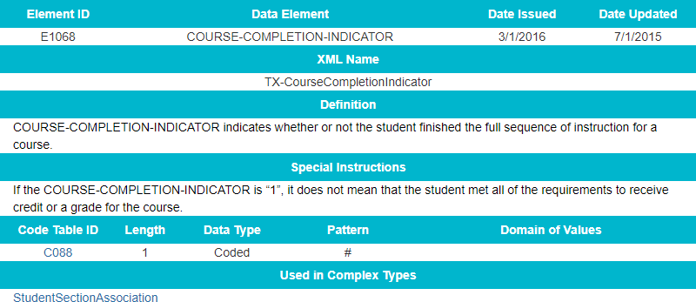
Grading and Course Completion
E1068 Course Completion Indicator
Missing and incomplete grades negatively impact course completion
For more details about the SutdentSectionAssociation, visit https://tealprod.tea.state.tx.us/TWEDS/94/0/0/0/DataComponents/ComplexType/List/10349

Slide 8
Campus Responsibilities
Each six-weeks cycle, campuses must:
Resolve missing grades, duplicate course enrollments, and overlapping courses prior to verifying and storing grades.
Generate progress reports and report cards; distribute to parents/guardians.
Send progress report and report card .pdf files to Federal and State Compliance.

Slide 9
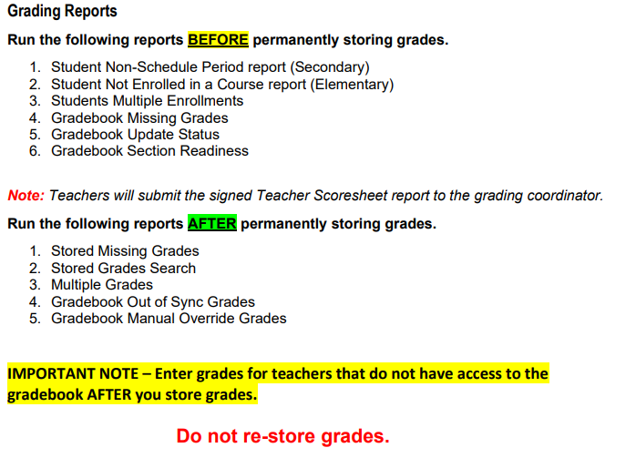
Grading Process – Reports
Reports to run BEFORE and AFTER permanently storing grades
.
16

Slide 10
SIS Newsline
Common Data Conditions
that Affect Report Cards
The reports mentioned in this communication must be clean to successfully generate report cards.
Please be sure to adhere to guidance provided in these communications.

Slide 11
Additional Essential Reports
Duplicate Course Enrollments (Systems Reports) – Errors on this report will cause report cards not to run due to duplicate courses.
Section Enrollment Audit (Systems Reports ) – Students with missing schedules.

Slide 12
Storing Grades
2022-2023 Grading Process

Slide 13
Grading Process – Storing Grades
Grades must be stored at the close of each Progress Report and Report Card grading cycle.
After the final grade term dates are set up, a school user runs the
Permanently Stored Grades process.
This process is an integral step in ensuring a snapshot of students’ grades from the teachers’ gradebooks are captured for the designated period for progress reports.
These grades will be stored in the students’ historical before the progress
reports are generated.

Slide 14
Grading Process – Storing Grades
To permanently store grades:
Start Page
Setup
System
Grades
Permanently Stored Grades
Store Grades Only Once – If you store multiple times, you will create duplicate grades.
You can store one section at
a time if you like.

Slide 15
SIS Resources/Tools
2022-2023 Grading Process

Slide 16
SIS Support
Follow guidance provided in SIS Newsline emails.
Contact your assigned SIS contact for setup and/or technical issues.
Send a ticket to servicedesk@houstonisd.org for immediate assistance.

Slide 17
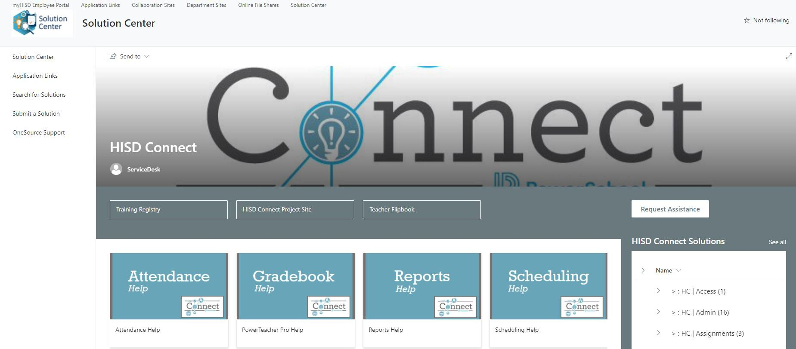
IT/SIS Support – Solution Center
Campuses can find a wealth of grading tools and resources in the Solution Center.
Solution Center https://houstonisd.share point.com/SolutionCente r/SitePages/HISD- Connect.aspx

Slide 18
Grade Process – FSC Contacts
Please contact your assigned FSC Sr. SIR for support or with questions regarding the grading process.
Name | Title
Zeno, Craig | Sr. Compliance Analyst
Garcia, Berta | Sr. Student Info Rep.
Shannon, Lisa | Sr. Student Info Rep.
Semien, Valencia | Sr. Student Info Rep.
Smith, LaTonya | Sr. Compliance Analyst
Hurts, Glennedo | Sr. Student Info Rep.
Palmer, Dachundralyn | Sr. Student Info Rep.
Salazar, Alma | Sr. Student Info Rep.
Thomas, Wanda | Sr. Compliance Analyst
Franco Betancourt, Rachel | Sr. Student Info Rep.
Freeman, Felicia | Sr. Student Info Rep.
Fuentes, Rose | Sr. Student Info Rep.
Vacant | Sr. Student Info Rep.

Slide 19
Thank you!

